Slide 1

AIDS
Title of the Project: AI in Disaster Prediction
Member:Atharva Shinde (54)
Professor Name:Dr.Ravita Mishra

Slide 2

Content
Overview
Introduction
Problem Statement
Objectives
Proposed System
Proposed Design
Conclusion

Slide 3
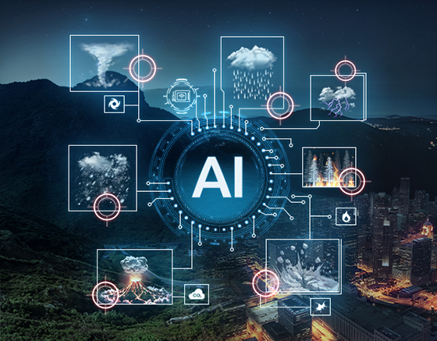
Introduction
r Rates
Disaster prediction uses data, models, and technology to anticipate natural disasters like earthquakes, floods, and wildfires. AI enhances disaster management by analyzing real-time data, detecting patterns, and improving prediction accuracy. Machine learning learns from past events, while IoT sensors and remote sensing provide real-time inputs for better forecasting. Early warning systems help save lives, reduce economic losses, and improve resource allocation for effective disaster response.

Slide 4
Problem Statement
Natural disasters are becoming more frequent and severe due to climate change. Traditional prediction methods often lack accuracy and fail to provide timely warnings, leading to loss of lives and economic damage. Governments struggle with limited real-time data and inadequate forecasting tools. AI-driven disaster prediction can enhance data processing, improve accuracy, and provide timely alerts. However, challenges like data availability, computational resources, and model reliability must be addressed for effective integration.

Slide 5
Existing Solution
Key Features:
Use of traditional meteorological models and seismic monitoring systems.
Satellite-based remote sensing for weather pattern analysis.
IoT sensors deployed in disaster-prone areas for data collection.
Early warning systems using statistical and physics-based models.
Limitations:
Limited accuracy in predicting sudden disasters like earthquakes.
Inability to process and analyze large volumes of real-time data efficiently.
Lack of integration between different disaster management systems.
Limited accessibility of advanced disaster prediction technologies in developing regions.

Slide 6
Solution
The proposed AI-driven disaster prediction system aims to enhance accuracy and response time by integrating real-time data, machine learning, and cloud-based analytics. The system will utilize deep learning models to analyze historical and real-time data, providing timely warnings and risk assessments. By leveraging IoT sensors, satellite imagery, and AI-based predictive models, the system will improve disaster preparedness and mitigation strategies.
Key Features:
AI-powered predictive models for disaster forecasting with high accuracy.
Real-time data processing using IoT devices and satellite imagery.
Cloud-based analytics for large-scale disaster monitoring.
Automated early warning system for rapid response.
Integration with government and emergency response frameworks.
User-friendly dashboards and mobile applications for public awareness.

Slide 7
Literature Survey
Sr.no | Title | Author | Publish Date /Year | Description
1 | A Review on Disaster Prediction Using Machine Learning | Alaa Taiseer Farghaly, Ngahzaifa Binti Ab Ghani, Abbas Saliimi Lokman | 2022 | This paper reviews machine learning techniques for predicting natural disasters like floods, earthquakes, and wildfires. It highlights the role of AI in improving prediction accuracy and response times through data analysis from sensors and remote sensing technologies.
2 | Artificial Neural Network Approaches for Disaster Management: A Literature Review | S. K. Saha, S. K. Ghosh | 2021 | This paper explores the use of artificial neural networks in predicting disasters like earthquakes and floods. It discusses how these models improve decision-making and response strategies in disaster management.

Slide 8
Proposed System
Data Collection Layer - Gathers real-time data from satellite imagery, weather stations, seismic sensors, and IoT devices.
Data Processing Module - Cleans, organizes, and preprocesses raw data for analysis.
AI & Machine Learning Models - Utilizes deep learning algorithms to detect patterns and predict potential disasters.
Cloud-based Analytics Platform - Provides scalable computing power for real-time disaster prediction and monitoring.
Early Warning System - Sends automated alerts to governments, emergency responders, and the public.
Visualization & Reporting Dashboard - Displays disaster predictions, risk levels, and response strategies in an interactive format.
Mobile Application & API Integration - Ensures accessibility to real-time predictions and alerts on multiple platforms.

Slide 9
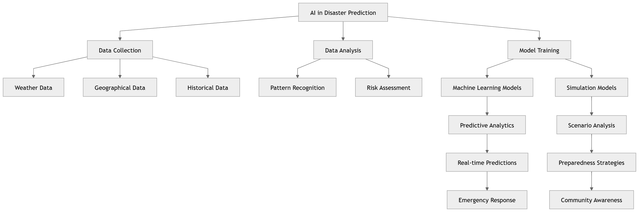
Proposed Design

Slide 10
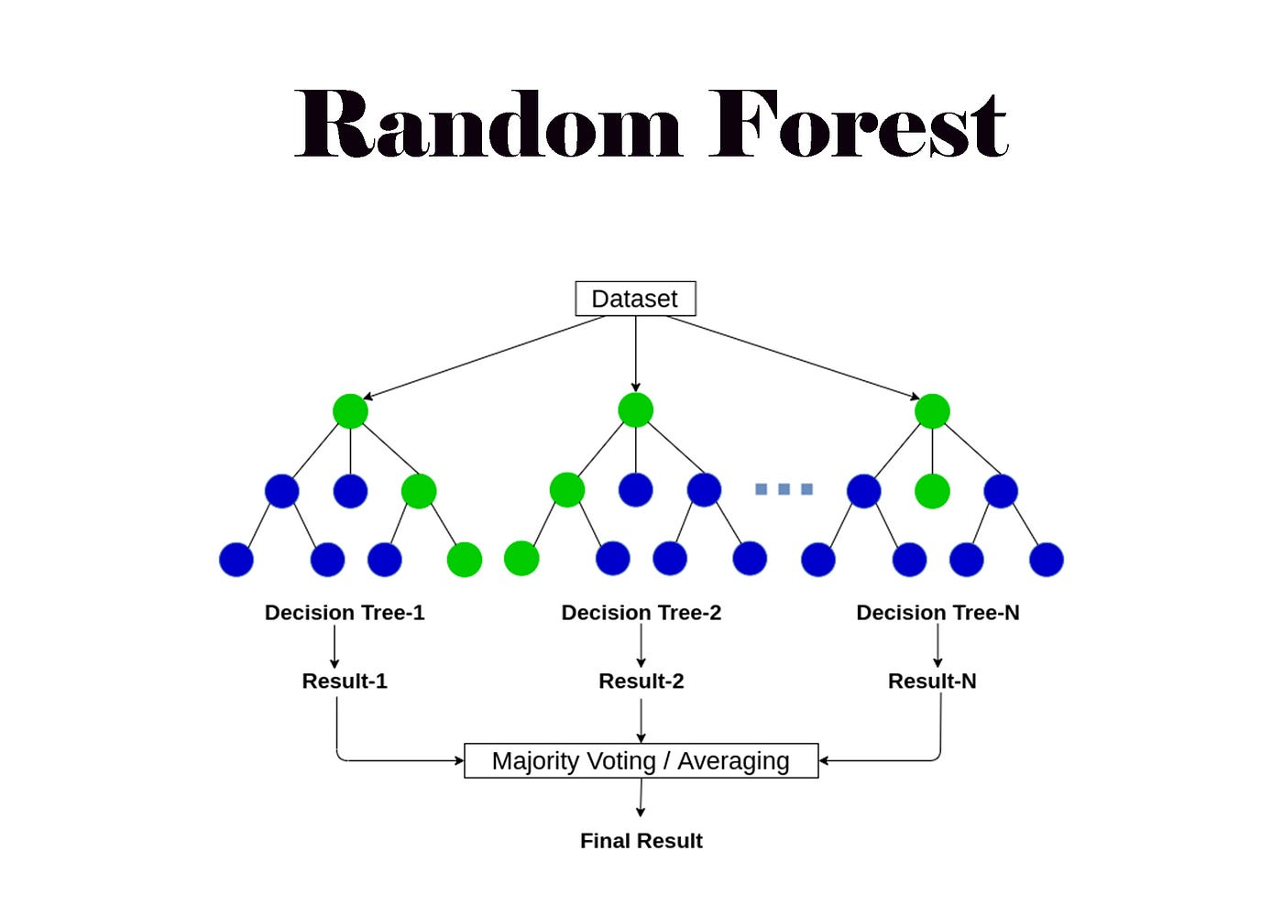
Algorithm Used
1. Convolutional Neural Networks (CNNs): Used for analyzing satellite imagery and identifying disaster-prone regions, especially for floods and wildfires.
2. Random Forest: A machine learning algorithm that analyzes multiple environmental factors and historical data to assess disaster risk levels.
3. Support Vector Machine (SVM): Used for classifying disaster events based on sensor and IoT data, aiding in earthquake and landslide predictions.
4. K-Means Clustering: Helps in identifying high-risk zones by grouping geographic areas based on environmental conditions and past disaster occurrences.
Notes:
The max flow algorithm in the visualization is :-

Slide 11
Conclusion
The integration of AI into disaster prediction significantly enhances forecasting accuracy, enabling timely interventions and reducing the impact of natural disasters. By leveraging machine learning, deep learning, and real-time data processing, the proposed system offers an innovative approach to disaster management. The use of AI-driven early warning systems ensures better preparedness, minimizes casualties, and optimizes resource allocation during emergencies. While challenges such as data availability and model reliability persist, continuous advancements in AI technology will further refine disaster prediction systems, ultimately contributing to a safer and more resilient society.

Slide 12
Refrences
[1]
S. Guha, R. K. Jana, and M. K. Sanyal, “Artificial neural network approaches for disaster management: A literature review,” International Journal of Disaster Risk Reduction, vol. 81, p. 103276, Oct. 2022, doi: https://doi.org/10.1016/j.ijdrr.2022.103276.
‌
[2]
R. K. Achterberg et al., “Thermal Emission From Saturn’s Polar Cyclones,” Geophysical Research Letters, vol. 45, no. 11, pp. 5312–5319, May 2018, doi:
https://doi.org/10.1029/2018gl078157.

